Slide 1




Sprites, PISA and Off-chain Channels
Patrick McCorry
with lots of help from Andrew Miller, Iddo Bentov, Surya Bakshi, Sarah Meiklejohn, Ranjit Kumaresan and Christopher Cordi.
paddyucl
Thanks for organising ->

Slide 2
Over two years of work within one hour!
Sprites: Payments Faster than Lightning https://arxiv.org/pdf/1702.05812.pdf
Pisa: Arbitration Outsourcing for State Channels
http://hackingdistributed.com/2018/05/22/pisa/
Empirically evaluate state channels as a scaling solution for cryptocurrencies
On-going work!

Slide 3
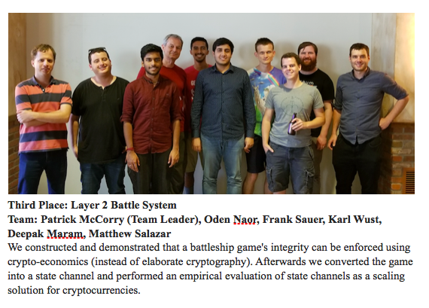
Third prize at IC3-Eth Hackathon!

Slide 4


Cryptocurrencies do not scale.
7 tps (sort of)
1 MB blocks
12 tps (sort of)
Complexity of transaction
https://github.com/stonecoldpat/anonymousvoting

Slide 5
In fact; Ethereum really doesn’t scale!
The Open Vote Network over Ethereum
Cryptographic protocol for privacy-preserving e-voting
El Gamal Encrypted Vote + One out of Two ZKP
3 votes every block (i.e. twelve seconds) congests entire network!
https://github.com/stonecoldpat/anonymousvoting
12 tps (sort of)
Complexity of transaction

Slide 6


What is the problem?
vs
“Decentralisation and Public Verifiability”
Large user-base vs Large set of validators

Slide 7
OK. How can we scale?
Centralised
“The chosen one” produces blocks and there is no competition!
Tweak Consensus Protocol
DAG blockchain, etc.
Sharding
Distribute processing across several shards
“Off-chain”
Local consensus amongst participants involved in application
Sidechain
Peg coins to “another” blockchain that is maintained by another group of maintainers.
Local Consensus (Channel)
All parties execute and authorise every update.

Slide 8
OK. How can we scale?
Centralised
“The chosen one” produces blocks and there is no competition!
Tweak Consensus Protocol
DAG blockchain, etc.
Sharding
Distribute processing across several shards
“Off-chain”
Local consensus amongst participants involved in application
Sidechain
Peg coins to “another” blockchain that is maintained by another group of maintainers.
Local Consensus (Channel)
All parties execute and authorise every update.

Slide 9
What is a “channel”?
Every party collectively authorises a new state of an application locally amongst themselves. The blockchain acts as a root of trust to guarantee safety
Essentially, each party is refunded the coins they deserve if one party does not co-operate off-chain.

Slide 10


Spilman Channels:
One-way Payment Channel
1.0 BTC
0.0 BTC
Step 1: Alice deposits coins into the channel

Slide 11
Spilman Channels:
One-way Payment Channel
1.0 BTC
0.0 BTC
Step 1: Alice deposits coins into the channel
Condition to release coins:
Both Alice and Bob authorise payment
OR
Alice waits until time T

Slide 12
Spilman Channels:
One-way Payment Channel
1.0 BTC
0.0 BTC
Step 2: Alice pays Bob 0.1 BTC

Slide 13
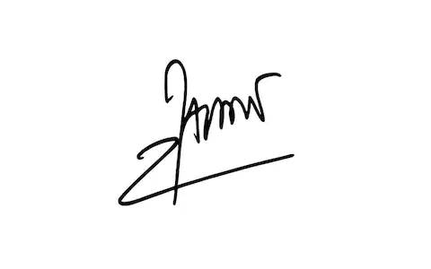
Spilman Channels:
One-way Payment Channel
1.0 BTC
0.0 BTC
Step 2: Alice pays Bob 0.1 BTC
Alice sends Bob the signature!

Slide 14
Spilman Channels:
One-way Payment Channel
0.9 BTC
0.1 BTC
Step 3: Bob must decide
Mutually sign payment and publish it
OR
Wait for a new payment from Alice

Slide 15
Spilman Channels:
One-way Payment Channel
0.8 BTC
0.2 BTC
Step 4: Alice pays Bob another 0.1 BTC

Slide 16
Spilman Channels:
One-way Payment Channel
0.0 BTC
1.0 BTC
Step K: Alice keeps paying bob… until she has no more coins!

Slide 17
Spilman Channels:
One-way Payment Channel
0.0 BTC
1.0 BTC
Final step: Bob signs and publishes the final payment he receives.
Overall Two transactions:
1 deposit transaction
1 payment transaction

Slide 18
Spilman Channels:
One-way Payment Channel
State Replacement Technique Unlocked:
Replace by Incentive
0.0 BTC
1.0 BTC
Final step: Bob signs and publishes the final payment he receives.

Slide 19
Every payment involves authorising a new “state”
There are several “state replacement” techniques:
Replace by Incentive (Spilman Channels)
Replace by Time Lock (Duplex Micropayment Channels)
Replace by Revocation (Lightning Channels)
…. Can we create a network of payment channels?

Slide 20
What single functionality do all payment channels support?
Spilman Payment Channels
Duplex Micropayment Channels
Lightning Channels
Raiden Channels

Slide 21
What single functionality do all payment channels support?
Spilman Payment Channels
Duplex Micropayment Channels
Lightning Channels
Raiden Channels
Conditional Transfers!

Slide 22
Conditional Transfer!
1.0 BTC
1.0 BTC

Slide 23
Conditional Transfer!
1 coin -> Bob
If <condition> is satisfied
1.0 BTC
1.0 BTC
Set up Transfer: Alice creates and signs a new transaction that lets Bob receive the coins… if….
“Bob, if you sign the transaction and reveal the pre-image of h before time T, then you can claim the coin!”

Slide 24
Conditional Transfer!
R
1.0 BTC
0.0 BTC
Ideal Case: Bob reveals R to Alice.
Both parties can update the channel and finalise the payment.

Slide 25
Conditional Transfer!
R
1.0 BTC
0.0 BTC
Worst Case: Both parties don’t co-operate offchain
Bob must broadcast transaction before time T and reveal R via the blockchain to claim his reward.

Slide 26
So why is that a big deal?
It let’s us synchronise channels on a single payment!

Slide 27

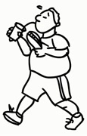
Synchronise all channels on a single payment!
What if Alice wants to pay Dave? But does not have a direct channel?
We can use conditional transfers (HTLC) to synchronise a payment across all intermediary channels!

Slide 28
Synchronise all channels on a single payment!
h, <payment info>
Step 1: Dave generates a secret R, computes the hash h = H(R) and sends to Alice.

Slide 29
Synchronise all channels on a single payment!
h, T+2
Step 2: Alice sets up a conditional transfer with Bob.
It expires T+2.
(where 2 is an extra delay)

Slide 30
Synchronise all channels on a single payment!
h, T+2
h, T+1
Step 3: Bob sets up a conditional transfer with Charlie.
It expires T+1.
(where 1 is an extra delay)

Slide 31
Synchronise all channels on a single payment!
h, T+2
h, T+1
h, T
Step 4: Charlie sets up a conditional transfer with Dave.
It expires T.
(no “extra” day)

Slide 32
Synchronise all channels on a single payment!
R
R
R
Best Case:
Dave reveals “R” to Charlie.
R is passed along the route, and at each hop the payment is settled off-chain.

Slide 33
When do I get my $X back?
h, T+2
h, T+1
h, T
Collateral costs: Money x Time “dollar-hours”

Slide 34
Synchronise all channels on a single payment!
h, T+2
h, T+1
h, T
Worst case:
Each channel has to settle conditional transfer via the blockchain.
Even worse, the expiry time is extended for every hop! Why?!

Slide 35
Synchronise all channels on a single payment!
h, T+2
h, T+1
h, T
Provide a “safe time period” for Bob to send coins,
and to claim coins from Alice
Every dispute is a LOCAL event

Slide 36
Synchronise all channels on a single payment!
h, T+2
h, T+1
h, T
Provide a “safe time period” for Bob to send coins,
and to claim coins from Alice
The “safe time period” is a LOCAL decision.
Sender must take into account all “safe time periods”

Slide 37
A “griefer / malice receiver” can hold up the coins for a sufficiently long time.
Longer the route - the bigger delay required for the sender!
Can we do better?

Slide 38


Slide 39


Synchronise all channels on a single payment!
Hey Payment Network Users! I’ll maintain a record a timestamp for every pre-image I receive!
Hash -> preimage, timestamp
Preimage Manager
Contract

Slide 40
Synchronise all channels on a single payment!
Hey Payment Network Users! I’ll maintain a record a timestamp for every pre-image I receive!
Hash -> preimage, timestamp
Only two functions!
function wasPreimageRevealedBy(T, h): returns bool
function submitPreimage(x): records h(x) => now
Preimage Manager
Contract

Slide 41
Synchronise all channels on a single payment!
h, T, M
New Conditional Transfer:
“Bob, you can claim these coins if the
pre-image of h is stored in the PreimageManager before time T”
We denote the manager as “M” for above cute picture.

Slide 42
Synchronise all channels on a single payment!
h, T, M
h,T,M
h,T,M
Constant case:
A dispute in one channel is a global event and automatically confirms the conditional transfer throughout the route
T represents the largest“safe time period” along the route.

Slide 43
Preimage Manager
Good, Bad And the Ugly
Constant time routing
Reduces “worst-case” in a payment network against a malice griefer
Conceptually simple, the “global” condition could also be used for other purposes
Maybe a hard-fork oracle? Or Virtual Channels?
If all channels dispute on-chain, doesn’t protect privacy
Not compatible with Pedro’s Protocol

Slide 44
Faster Routing is great… but is that it?

Slide 45

Faster Routing is great… but is that it?
No!
There is a generic state channel construction to support a group of N parties!

Slide 46
Every payment involves authorising a new “state”
There are several “state replacement” techniques:
Replace by Incentive (Spilman Channels)
Replace by Time Lock (Duplex Micropayment Channels)
Replace by Revocation (Lightning Channels)
But… problems emerge due to Bitcoin’s scripting facility:
More than two parties is hard / awkward.
The “state” is restricted to the balance of both parties
Building anything else is exceedingly difficult

Slide 47
Ethereum to the rescue?
Can we do any better if the platform’s scripting language is more expressive?

Slide 48
Can we do better? Yes!
N Parties
All parties authorise every update
Issue Commands
All parties replicate each state transition before authorising the new state
Safety *and* Liveness
Dispute process enforces a state transition and does not close the channel!
Sprites State Channel Construction: https://arxiv.org/abs/1702.05812

Slide 49
A whole host of channel constructions!
Spilman Payment Channels
Duplex Micropayment Channels
Lightning Channels
Raiden Channels
Sprites Channels (now!)
Perun Channels
Counterfactual

Slide 50
A whole host of channel constructions!
Spilman Payment Channels
Duplex Micropayment Channels
Lightning Channels
Raiden Channels
Sprites Channels (now!)
Perun Channels
Counterfactual
Our bootcamp project will try to combine all three into an awesome dispute process!
I’ll explain at the end! Eppp!

Slide 51
A Trusted Third Party with Public State
Hey, I’m a smart contract.
I promise you the following:
I will never modify or change your code.
I will always run the code you tell me too (assuming the code itself allows me!).
I will never let code execution “stop half way” it is ALL or NOTHING with me.
I like to gossip and I can’t keep secrets - Everything you tell me will be public knowledge.

Slide 52
New State Replacement Technique
State Channel Contract

Slide 53
Replace by Monotonic Counter (or Version)
Increment Counter
Every new update increments a counter and requires all parties to sign it!
State 0
Alice: 1 ETH
Bob: 1 ETH
Charlie: 1 ETH
Counter: 0

Slide 54
Replace by Monotonic Counter (or Version)
Increment Counter
Every new update increments a counter and requires all parties to sign it!
State 0
Alice: 1 ETH
Bob: 1 ETH
Charlie: 1 ETH
Counter: 0
State 1
Alice: 0.9 ETH
Bob: 1.1 ETH
Charlie: 1 ETH
Counter: 1

Slide 55
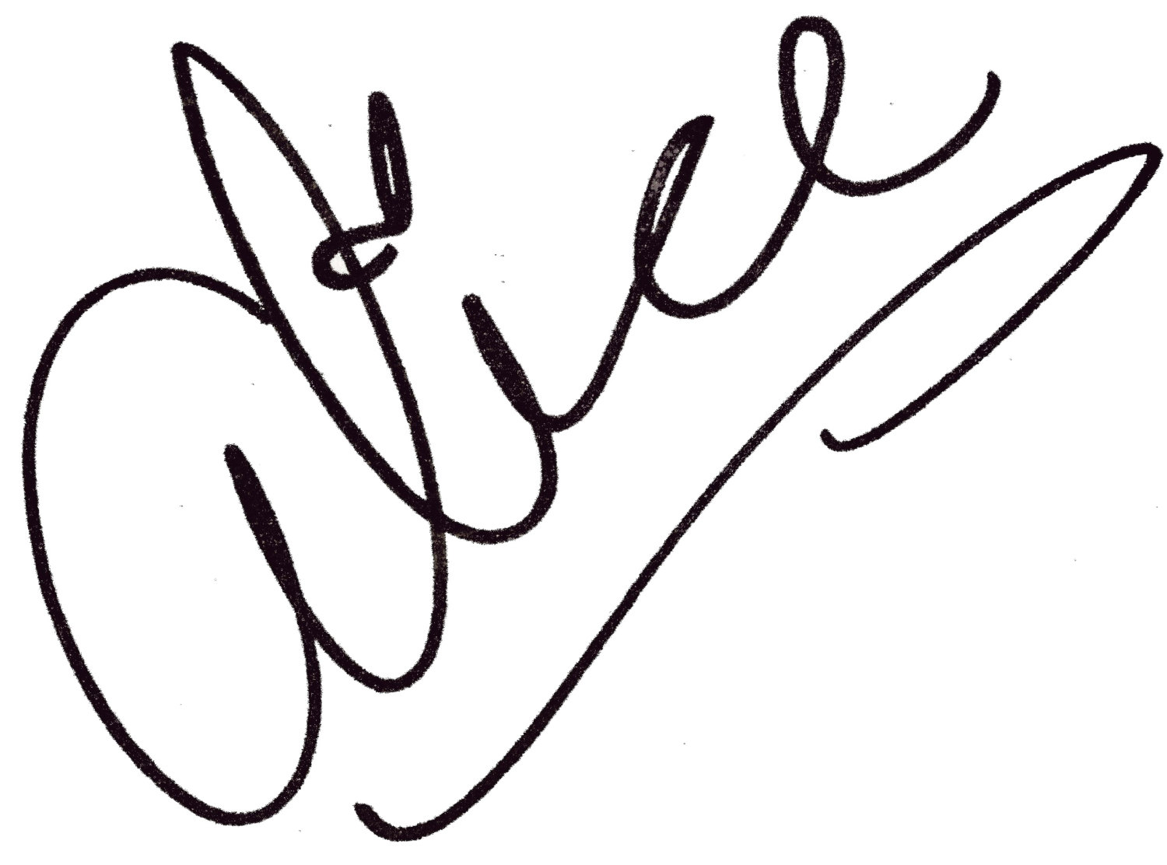
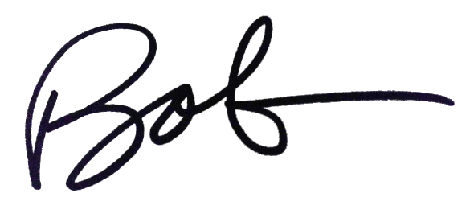
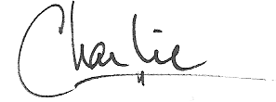
Replace by Monotonic Counter (or Version)
Increment Counter
Every new update increments a counter and requires all parties to sign it!
State 0
Alice: 1 ETH
Bob: 1 ETH
Charlie: 1 ETH
Counter: 0
State 1
Alice: 0.9 ETH
Bob: 1.1 ETH
Charlie: 1 ETH
Counter: 1

Slide 56
Replace by Monotonic Counter (or Version)
Increment Counter
Every new update increments a counter and requires all parties to sign it!
State 0
Alice: 1 ETH
Bob: 1 ETH
Charlie: 1 ETH
Counter: 0
State 1
Alice: 0.9 ETH
Bob: 1.1 ETH
Charlie: 1 ETH
Counter: 1

Slide 57
Replace by Monotonic Counter (or Version)
Increment Counter
Every new update increments a counter and requires all parties to sign it!
State 0
Alice: 1 ETH
Bob: 1 ETH
Charlie: 1 ETH
Counter: 0
State 1
Alice: 0.9 ETH
Bob: 1.1 ETH
Charlie: 1 ETH
Counter: 1

Slide 58
Replace by Monotonic Counter (or Version)
Increment Counter
Every new update increments a counter and requires all parties to sign it!
State 0
Alice: 1 ETH
Bob: 1 ETH
Charlie: 1 ETH
Counter: 0
State 1
Alice: 0.9 ETH
Bob: 1.1 ETH
Charlie: 1 ETH
Counter: 1
State 2
Alice: 0.0 ETH
Bob: 0.0 ETH
Charlie: 3 ETH
Counter: 2

Slide 59
Replace by Monotonic Counter (or Version)
Increment Counter
Every new update increments a counter and requires all parties to sign it!
State 0
Alice: 1 ETH
Bob: 1 ETH
Charlie: 1 ETH
Counter: 0
State 1
Alice: 0.9 ETH
Bob: 1.1 ETH
Charlie: 1 ETH
Counter: 1
State 2
Alice: 0.0 ETH
Bob: 0.0 ETH
Charlie: 3 ETH
Counter: 2

Slide 60
Replace by Monotonic Counter (or Version)
Increment Counter
Every new update increments a counter and requires all parties to sign it!
Contract (or blockchain)
Accepts state with the largest counter as the “latest” state
State 0
Alice: 1 ETH
Bob: 1 ETH
Charlie: 1 ETH
Counter: 0
State 1
Alice: 0.9 ETH
Bob: 1.1 ETH
Charlie: 1 ETH
Counter: 1
State 2
Alice: 0.0 ETH
Bob: 0.0 ETH
Charlie: 3 ETH
Counter: 2

Slide 61
Fair Exchange of Signatures
and
Self-enforcing state transitions

Slide 62
Step 1: Initiating State Transition
*some parameters omitted for clarity
One party initiates a new state transition:
State i

Slide 63
Step 1: Initiating State Transition
*some parameters omitted for clarity
One party initiates a new state transition:
Select a command cmd
Selects “Play Hand”
State i

Slide 64
Step 1: Initiating State Transition
*some parameters omitted for clarity
One party initiates a new state transition:
Select a command cmd
Compute new state as: state_{i+1} = transition( cmd, state_{i} )
Compute new state
State i
State i+1

Slide 65
Step 1: Initiating State Transition
*some parameters omitted for clarity
One party initiates a new state transition:
Select a command cmd
Compute new state as: state_{i+1} = transition( cmd, state_{i} )
Sign new state_{i+1} and Sign the cmd.
Signs two messages!
State i
State i+1

Slide 66
Step 1: Initiating State Transition
*some parameters omitted for clarity
One party initiates a new state transition:
Select a command cmd
Compute new state as: state_{i+1} = transition( cmd, state_{i} )
Sign new state_{i+1} and Sign the cmd.
Send all other parties the cmd, both signatures and new state.
σ_{A}, cmd, state_{i+1}
σ_{A}, cmd, state_{i+1}
State i
State i+1

Slide 67
Step 2: Verifying and Authorising the New State
*some parameters omitted for clarity
All parties verify the new state:
σ_{A}, cmd, state_{i+1}
σ_{A}, cmd, state_{i+1}
State i
State i+1

Slide 68
Step 2: Verifying and Authorising the New State
*some parameters omitted for clarity
All parties verify the new state:
Verify signature for the new state and cmd.
Verify signature for state + command
Verify signature for state + command
State i
State i+1

Slide 69
Step 2: Verifying and Authorising the New State
*some parameters omitted for clarity
All parties verify the new state:
Verify signature for the new state and cmd.
Verify i+1 is the largest counter received so far
Largest counter so far?
Largest counter so far?
State i
State i+1

Slide 70
Step 2: Verifying and Authorising the New State
*some parameters omitted for clarity
All parties verify the new state:
Verify signature for the new state and cmd.
Verify i+1 is the largest counter received so far
Compute state transition: state’_{i+1} = transition( cmd, state_{i} )
Compute new state
Compute new state
State i
State i+1

Slide 71
Step 2: Verifying and Authorising the New State
*some parameters omitted for clarity
All parties verify the new state:
Verify signature for the new state and cmd.
Verify i+1 is the largest counter received so far
Compute state transition: state’_{i+1} = transition( cmd, state_{i} )
Verify state’_{i+1} == state_{i+1}
Compare computed state with signed state
Compare computed state with signed state
State i
State i+1

Slide 72
Step 2: Verifying and Authorising the New State
*some parameters omitted for clarity
All parties verify the new state:
Verify signature for the new state and cmd.
Verify i+1 is the largest counter received so far
Compute state transition: state’_{i+1} = transition( cmd, state_{i} )
Verify state’_{i+1} == state_{i+1}
Sign state’_{i+1} and send all other parties the signature and new state.
σ_{C}, cmd, state_{i+1}
σ_{C}, cmd, state_{i+1}
State i
State i+1

Slide 73
Step 2: Verifying and Authorising the New State
*some parameters omitted for clarity
All parties verify the new state:
Verify signature for the new state and cmd.
Verify i+1 is the largest counter received so far
Compute state transition: state’_{i+1} = transition( cmd, state_{i} )
Verify state’_{i+1} == state_{i+1}
Sign state’_{i+1} and send all other parties the signature and new state.
σ_{B}, cmd, state_{i+1}
σ_{B}, cmd, state_{i+1}
State i
State i+1

Slide 74
Step 2: Verifying and Authorising the New State
*some parameters omitted for clarity
All parties verify the new state:
Verify signature for the new state and cmd.
Verify i+1 is the largest counter received so far
Compute state transition: state’_{i+1} = transition( cmd, state_{i} )
Verify state’_{i+1} == state_{i+1}
Sign state’_{i+1} and send all other parties the signature and new state.
σ_{A,}σ_{B},σ_{C}, state_{i+1}
σ_{A,}σ_{B},σ_{C}, state_{i+1}
σ_{A,}σ_{B},σ_{C}, state_{i+1}
State i
State i+1

Slide 75
What if one party does not co-operate and does not sign the new state update?
Time to self-enforce it via the dispute process!

Slide 76
The Dispute Process
What if everyone doesn’t authorise the new state?

Slide 77
The Dispute Process
What if everyone doesn’t authorise the new state?
Update State
One party can publish a state that was authorised by all parties.
(current state of poker game)
Block 1
Update State

Slide 78
The Dispute Process
What if everyone doesn’t authorise the new state?
Initiate Dispute
One party can initiate the dispute process.
Sets a fixed time period for all parties to respond.
Block 1
Block 2
Update State
Initiate Dispute

Slide 79
The Dispute Process
What if everyone doesn’t authorise the new state?
Input Command
All parties can input a “command” to dictate how the state should transition.
Block 1
Block 2
Block 3
Block 4
Block ...
Block N-1
Update State
Initiate Dispute
Alice cmd
Bob cmd

Slide 80
The Dispute Process
What if everyone doesn’t authorise the new state?
Resolve Dispute
Contract selects one (or all) commands and executes the state transition from state_{i} to state_{i+1}.
Block 1
Block 2
Block 3
Block 4
Block ...
Block N-1
Block N
Update State
Initiate Dispute
Alice cmd
Bob cmd
Resolve Dispute

Slide 81
Execution Fork
One party can try to self-enforce a state transition to replace a state already authorised off-chain!
Example:
Alice pays Bob off-chain, but authorises a withdrawal via the dispute process. Payment is no longer valid!

Slide 82
Always online assumption:
All parties must remain online to detect and defend against execution forks

Slide 83
Always online assumption:
All parties must remain online to detect and defend against execution forks
Old State
Alice updates the blockchain with an older state_{i-1}
σ_{A,}σ_{B,}σ_{C},state_{i-1}
Block 1
Update State

Slide 84
Always online assumption:
All parties must remain online to detect and defend against execution forks
Initiates Dispute
Alice prepares to perform execution fork
σ_{A,},cmd
Block 1
Block 2
Block 3
Update State
Initiate Dispute
Alice cmd

Slide 85
Always online assumption:
All parties must remain online to detect and defend against execution forks
AHHH OH NO
σ_{A,}σ_{B,}σ_{C},state_{i}
Block 1
Block 2
Block 3
Block 4
Update State
Initiate Dispute
Alice cmd
Update State

Slide 86
Always online assumption:
All parties must remain online to detect and defend against execution forks
Execution Fork is Cancelled!
All commands are cancelled and the contract reflects the most recently authorised off-chain state.
Block 1
Block 2
Block 3
Block 4
Block ...
Block N-1
Block N
Update State
Initiate Dispute
Alice cmd
Update State

Slide 87
Can we help alleviate this new security requirement?

Slide 88


Slide 89
Related work: Outsource responsibility
Monitor by Tadge (Scaling Bitcoin 2016)
State privacy
Not verifiable that “encrypted blob” is a real state!
O(n) storage for Monitor
Every new encrypted blob must be stored
Rewarded only when resolving a dispute
No guaranteed payment for service
No Accountability
No evidence of appointment
WatchTower by Roasbeef (BPASE 2018)
State privacy
Collectively signed hash
O(1) storage for WatchTower
Requires new consensus rules in Bitcoin (pretty much adopts “replace by counter”)
Rewarded via micropayment
No accountability
No evidence of appointment

Slide 90


 | Privacy Preserving | Verifiable Job | Storage | Fair Exchange (Job + Reward) | Publicly Verifiable Warrant | Financial Deterrent (and Accountability) | Deployable Today
Monitor |  |  | O(N)
WatchTower |  |  | O(1)
All good!
Not in original protocol,
but compatible
Nope

Slide 91
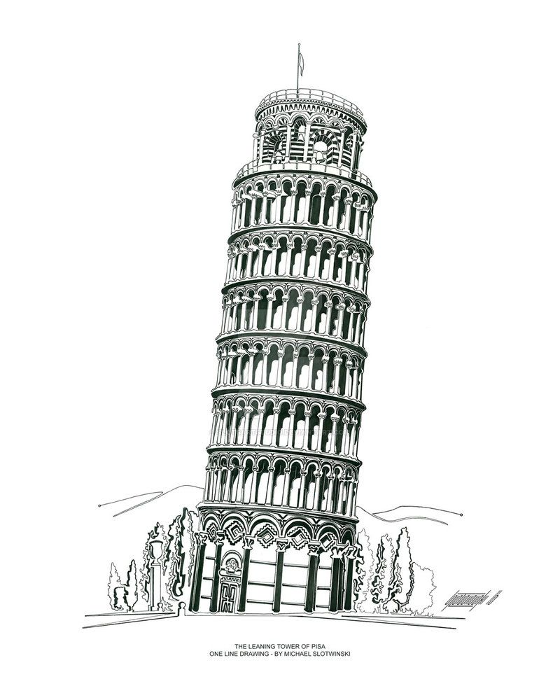
Pisa: Arbitration Outsourcing
for N party state channels
State Privacy
Custodian should not learn about the state he is watching (unless there is a dispute on-chain!)
Fair Exchange
Custodian should be paid upon accepting appointment from customer
O(1) Storage
Custodian only has to store the latest job received from the customer!
Recourse as Financial Deterrent
There should be indisputable evidence that can be used to punish a malice Custodian

Slide 92
Setting up Custodian in Pisa
Custodian Contract
Stores a large security deposit upon set up.
Deposit can only be withdrawn after a fixed period of time.

Slide 93
Setting up Custodian in Pisa
Custodian Contract
Stores a large security deposit upon set up.
Deposit can only be withdrawn after a fixed period of time.

Slide 94
Setting up Custodian in Pisa
Custodian Contract
Stores a large security deposit upon set up.
Deposit can only be withdrawn after a fixed period of time.

Slide 95
Setting up Custodian in Pisa
Custodian Contract
Stores a large security deposit upon set up.
Deposit can only be withdrawn after a fixed period of time.

Slide 96
Achieving State Privacy in Pisa

Slide 97
Achieving State Privacy in Pisa
State Channel Construction Modification:
All parties sign the hash of a new state (and not the state itself)
Hired Custodian receives:
The state hash, counter, and signature from all parties.

Slide 98
Achieving State Privacy in Pisa
*some parameters omitted for clarity
Let’s revisit how to initiate a new state
Select a command cmd
Compute new state as: state_{i+1} = transition( cmd, state_{i} )
Compute nonce r
Compute state hash h_{i+1} = H(state_{i+1,}r)
Sign the state hash:
σ = Sign(sk, (h, i+1))
Send all other parties the cmd, signature, new state, and the nonce.
Hash state with random nonce and sign it.

Slide 99
Achieving State Privacy in Pisa
*some parameters omitted for clarity
Let’s revisit how to initiate a new state
Select a command cmd
Compute new state as: state_{i+1} = transition( cmd, state_{i} )
Compute nonce r
Compute state hash h_{i+1} = H(state_{i+1,}r)
Sign the state hash:
σ = Sign(sk, (h, i+1))
Send all other parties the cmd, signature, new state, and the nonce.
cmd, i+1,, H(state_{i+1},r), r
cmd, i+1, H(state_{i+1},r), r

Slide 100
Achieving State Privacy in Pisa
*some parameters omitted for clarity
Let’s revisit how parties verify a new state
Compute transition: state_{i+1} = transition( cmd, state_{i} )
Compute h_{i+1} = H(state_{i+1,}r)
Verify signature for state hash:
b = VerifySignature(σ, (h, i+1))
Sign the state hash:
σ = Sign(sk, (h, i+1))
Send all other parties the cmd, signature, new state and the nonce.
All parties independently compute new state and verify the state hash.

Slide 101
Achieving State Privacy in Pisa
σ_{A,}σ_{B},σ_{C}, H(state_{i+1},r)
Hired Custodian receives:
The state hash, counter, and signature from all parties.

Slide 102
Fair Exchange of Appointment & Payment in Pisa

Slide 103
Fair Exchange of Appointment & Payment in Pisa
How to send payment to custodian?
Pay via a payment network
i.e. Lightning or Raiden
Pay within a one-way payment channel
Replace by Incentive, presented earlier.

Slide 104
Fair Exchange of Appointment & Payment in Pisa
Some assumptions to simplify presentation:
Custodian has a copy of state channel address
They know what contract to watch and where to settle disputes
Appointment information pre-aggred
Payment amount
Time period for watching

Slide 105
Fair Exchange of Appointment & Payment in Pisa
*some parameters omitted for clarity
New Appointment: σ_{A,}σ_{B,}σ_{C},h_{i+1}, i+1
Step 1: Send Appointment/Job to Custodian

Slide 106
Fair Exchange of Appointment & Payment in Pisa
*some parameters omitted for clarity
New Appointment: σ_{A,}σ_{B,}σ_{C},h_{i+1}, i+1
Step 2:
Custodian performs sanity checks (i.e. signatures, largest nonce so far, etc).

Slide 107
Fair Exchange of Appointment & Payment in Pisa
*some parameters omitted for clarity
New Appointment: σ_{A,}σ_{B,}σ_{C},h_{i+1}, i+1
Signed Receipt: <appointment>, h_{receipt},σ_{custodian}
Step 3:
Custodian creates receipt, computes h_{receipt} = H(s),
signs the receipt and sends to the customer.

Slide 108
Fair Exchange of Appointment & Payment in Pisa
*some parameters omitted for clarity
New Appointment: σ_{A,}σ_{B,}σ_{C},h_{i+1}, i+1
Signed Receipt: <appointment>, h_{receipt},σ_{custodian}
Conditional Transfer: <coins>, h_{receipt}, Expiry_Time, σ_{B}
Step 4: Customer checks custodian’s signature (and appointment information).
If happy, customer creates, signs and sends a conditional transfer.

Slide 109
Fair Exchange of Appointment & Payment in Pisa
*some parameters omitted for clarity
New Appointment: σ_{A,}σ_{B,}σ_{C},h_{i+1}, i+1
Signed Receipt: <appointment>, h_{receipt},σ_{custodian}
Conditional Transfer: <coins>, h_{receipt}, Expiry_Time, σ_{B}
Ratify Receipt: Reveal “s”
Final Step: Custodian reveals secret “s” for h_{receipt} to customer before the expiry time. This ratifies receipt and allows custodian to claim transfer.

Slide 110
Fair Exchange of Appointment & Payment in Pisa
*some parameters omitted for clarity
New Appointment: σ_{A,}σ_{B,}σ_{C},h_{i+1}, i+1
Signed Receipt: <appointment>, h_{receipt},σ_{custodian}
Conditional Transfer: <coins>, h_{receipt}, Expiry_Time, σ_{B}
Ratify Receipt: Reveal “s”
Receipt is only ratified if “s” is revealed.
Conditional transfer is only valid if both parties agree or if it is settled directly on the blockchain before expiry time.

Slide 111
Alice and the Custodian collude to cheat Bob?

Slide 112

Recourse as a financial deterrent in Pisa
Alice broadcasts an older state…
let’s pretend it is state i-1
Block 1
Update State
i-1

Slide 113
Recourse as a financial deterrent in Pisa
Block 1
Block 2
Update State
i-1
Initiate Dispute

Slide 114
Recourse as a financial deterrent in Pisa
Custodian *could* publish newer start and cancel the dispute… but doesn’t!! 😱😱😱😱😱
Block 1
Block 2
Block 3
Block 4
Update State
i-1
Initiate Dispute
Alice cmd

Slide 115
Recourse as a financial deterrent in Pisa
Too late… execution fork occurs!
… but we assume a record of this dispute state i-1 is recorded!
Block 1
Block 2
Block 3
Block 4
Block N
Update State
i-1
Initiate Dispute
Alice cmd
Resolve

Slide 116
Recourse as a financial deterrent in Pisa
OH NO! The Custodian cheated me!!!! I’ve lost all my coins! 😡😡😡😡😡😡

Slide 117
Recourse as a financial deterrent in Pisa
Cryptographic Evidence of Wrongdoing
If Bob can prove to the custodian contract about the custodian’s wrongdoing, then the full deposit will be burnt!

Slide 118
Recourse as a financial deterrent in Pisa
Cryptographic Evidence of Wrongdoing
If Bob can prove to the custodian contract about the custodian’s wrongdoing, then the full deposit will be burnt!
Custodian Contract

Slide 119
Recourse as a financial deterrent in Pisa
Cryptographic Evidence of Wrongdoing
If Bob can prove to the custodian contract about the custodian’s wrongdoing, then the full deposit will be burnt!
Signed (and Ratified) Receipt
Custodian Contract

Slide 120
Recourse as a financial deterrent in Pisa
Custodian was hired to cancel disputes for states older than counter i.
Did he?
Custodian Contract

Slide 121
Recourse as a financial deterrent in Pisa
Investigation in Progress
*looks up Bob’s state channel contract*
*finds dispute for state i-1*
Custodian Contract

Slide 122
Recourse as a financial deterrent in Pisa
Custodian could have cancelled the dispute… and he didn’t….
Sorry man. Your deposit is frozen!
Custodian Contract

Slide 123
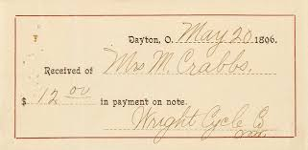
Recourse as a financial deterrent in Pisa
Revenge is sweet
+
Dispute Record*
State channel contract records all successful disputes
Ratified signed receipt
Evidence custodian promised to prevent execution fork

Slide 124
Pisa: Arbitration Outsourcing
for N party state channels
State Privacy
Custodian should not learn about the state he is watching (unless there is a dispute on-chain!)
Fair Exchange
Custodian should be paid upon accepting appointment from customer
O(1) Storage
Custodian only has to store the latest job received from the customer!
Recourse as Financial Deterrent
There should be indisputable evidence that can be used to punish a malice Custodian

Slide 125
 | Privacy Preserving | Verifiable Job | Storage | Fair Exchange (Job + Reward) | Publicly Verifiable Warrant | Financial Deterrent (and Accountability) | Deployable Today
Monitor |  |  | O(N)
WatchTower |  |  | O(1)
PISA |  |  | O(1)
All good!
Not in original protocol,
but compatible
Nope

Slide 126

Summary of Pisa
A state channel construction that can support arbitrary applications
Safety: parties always get the coins they deserve
Liveness: the application will always continue - we no longer close the channel
An accountable third party who will watch the channel on the customer’s behalf
Recourse and financial deterrent
Cryptographic warrant of appointment
O(1) storage for every customer
Off-chain reward policy
Future work?
Empirically evaluate applications in a state channel

Slide 127
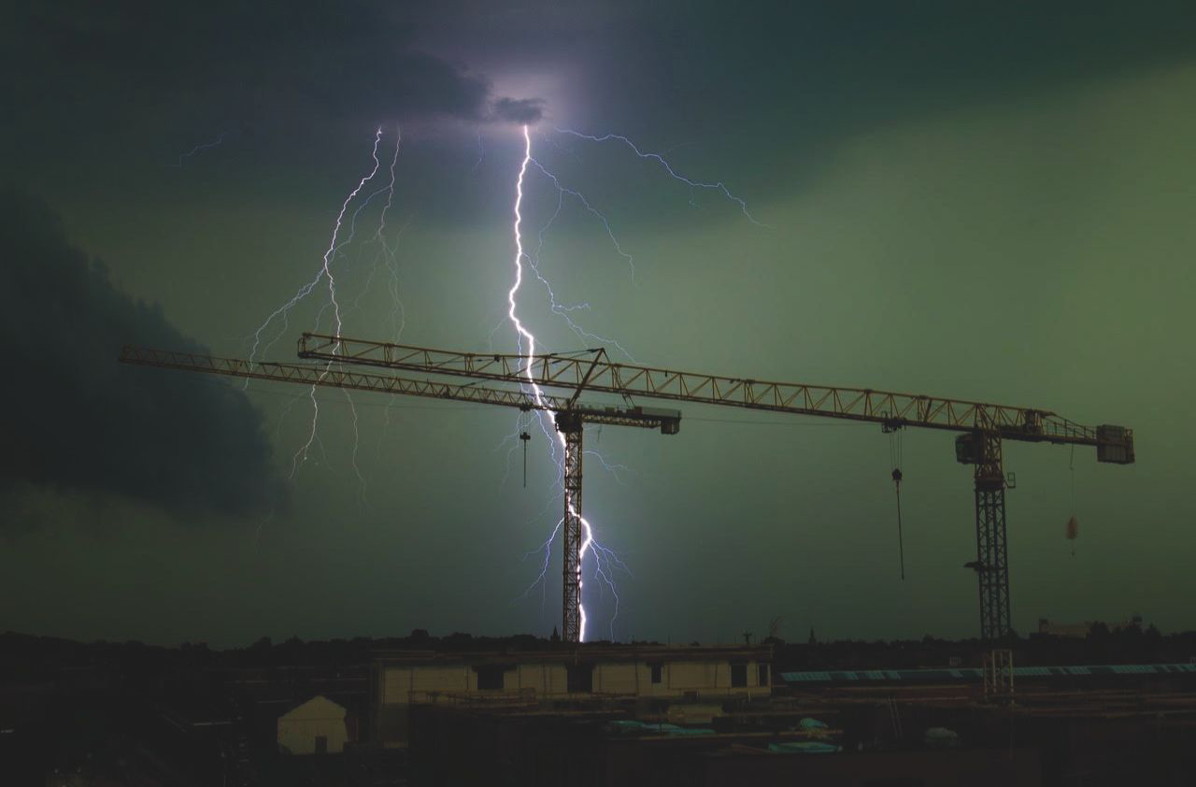

Slide 128
An empirical evaluation of state channels as a scaling solution for cryptocurrencies

Slide 129

What are we trying to do?
Practically demonstrate the minimal modifications required to an application before it can be deployed as a state channel
Two “extra” functions
A few fixed variables (list of participants, dispute time, etc)
What applications are compatible state channels?
Everyone must be online to authorise state updates
What are the inherent weaknesses?
Funfair Dilemma

Slide 130
A new life-cycle
Application Contract
Function lock()
Upon approval of all parties, lock all functionality and launch the state channel
Function unlock(state, r)
After the “state channel” is closed - accepts “full state” and re-enables functionality

Slide 131
A new life-cycle
σ_{A,}σ_{B},σ_{C}, “unlock”
Application Contract

Slide 132
A new life-cycle
Everyone signs the “lock” message
σ_{A,}σ_{B},σ_{C}, “unlock”
Application Contract

Slide 133
A new life-cycle
Everyone signs the “lock” message
Application contract receives “lock” message.
σ_{A,}σ_{B},σ_{C}, “unlock”
Application Contract

Slide 134
A new life-cycle
Everyone signs the “lock” message
Application contract receives “lock” message.
σ_{A,}σ_{B},σ_{C}, “unlock”
Application Contract

Slide 135
A new life-cycle
Everyone signs the “lock” message
Application contract receives “lock” message.
σ_{A,}σ_{B},σ_{C}, “unlock”
Application Contract

Slide 136

A new life-cycle
Everyone signs the “lock” message
Application contract receives “lock” message.
Locks ALL functionality
Instantiates state channel contract
State Channel Contract
Application Contract

Slide 137
A new life-cycle
Everyone signs the “lock” message
Application contract receives “lock” message.
Locks ALL functionality
Instantiates state channel contract
All parties run the application “off-chain”
Someone executes a function
battleship.shot()
State Channel Contract
Application Contract

Slide 138
A new life-cycle
Everyone signs the “lock” message
Application contract receives “lock” message.
Locks ALL functionality
Instantiates state channel contract
All parties run the application “off-chain”
Someone executes a function
All parties sign hash of new state
State Channel Contract
σ_{A,}σ_{B},σ_{C}, h(state_{i+1},r_{i+1}), i+1
Application Contract

Slide 139
A new life-cycle
Everyone signs the “lock” message
Application contract receives “lock” message.
Locks ALL functionality
Instantiates state channel contract
All parties run the application “off-chain”
Someone executes a function
All parties sign hash of new state
State Channel Contract
Application Contract

Slide 140
A new life-cycle
Everyone signs the “lock” message
Application contract receives “lock” message.
Locks ALL functionality
Instantiates state channel contract
All parties run the application “off-chain”
Someone executes a function
All parties sign hash of new state
One party triggers dispute to “turn off” the channel
State Channel Contract
Application Contract

Slide 141
The Dispute Process
What if everyone doesn’t authorise the new state?

Slide 142
The Dispute Process
What if everyone doesn’t authorise the new state?
Initiate Dispute
One party can initiate the dispute process.
Sets a fixed time period for all parties to respond.
Block 1
Initiate Dispute

Slide 143
The Dispute Process
What if everyone doesn’t authorise the new state?
Input state hash
All parties can hash of latest state (alongside counter)
Block 1
Block 2
Block 3
Block ...
Block N-1
Initiate Dispute
hstate,
i
hstate,
i+1

Slide 144
The Dispute Process
What if everyone doesn’t authorise the new state?
Resolve Dispute
hstate, i+1 stored as the final commitment
Block 1
Block 2
Block 3
Block ...
Block N-1
Block N
Initiate Dispute
hstate,
i
hstate, i+1
Resolve Dispute

Slide 145
Re-activation!
unlock(state, r)
State Channel Contract
Application Contract
Step 1: Alice sends over full state (and blinding r)

Slide 146
Re-activation!
unlock(state, r)
getStateHash()
State Channel Contract
Application Contract
Step 2: AppCon fetches commitment to state (hstate) from state channel

Slide 147
Re-activation!
unlock(state, r)
getStateHash()
hstate
State Channel Contract
Application Contract
Step 3: AppCon checks that H(state, r) == hstate

Slide 148
Re-activation!
unlock(state, r)
getStateHash()
All good!
hstate
State Channel Contract
Application Contract
Step 4: AppCon stores state and re-activates all functionality

Slide 149
Re-activation!
unlock(state, r)
getStateHash()
All good!
hstate
State Channel Contract
Application Contract
Summary: Update all variables in the AppCon (i.e. the “state”) and re-enable all functionality to continue execution via the blockchain

Slide 150
Re-activation!
unlock(state, r)
getStateHash()
All good!
hstate
State Channel Contract
Application Contract
Summary: Update all variables in the AppCon (i.e. the “state”) and re-enable all functionality to continue execution via the blockchain

Slide 151
Empirical Evaluation Thoughts
Funfair Dilemma
“Minimise on-chain state vs Minimise off-chain state”
Why? Dispute process is expensive!
Is deploying full battleship contract worth it for a $10 dispute?
Applications of State Channels
All parties are always on-line, and continuous execution of protocol
When does this actually make sense?
Does the EVM/Solidity cause problems?
Yes! Mappings are terrible! Easy attack vectors!

Slide 152
Two years later.
We are on the verge of practical and deployable state channels.
Magic unicorns need not apply.
Thanks for organising ->

Slide 153


